Slide 1
CICOTI Mozambique: BAT QBR 2 and QBR 3 October 2018

Slide 2
Overview
Volume by Region
2018 Budget Versus Actual
Top Customers
Branch Performance
G4S Project
AC Analysis
Fleet Analysis Report
Break Down Report
Vilanculos.

Slide 3
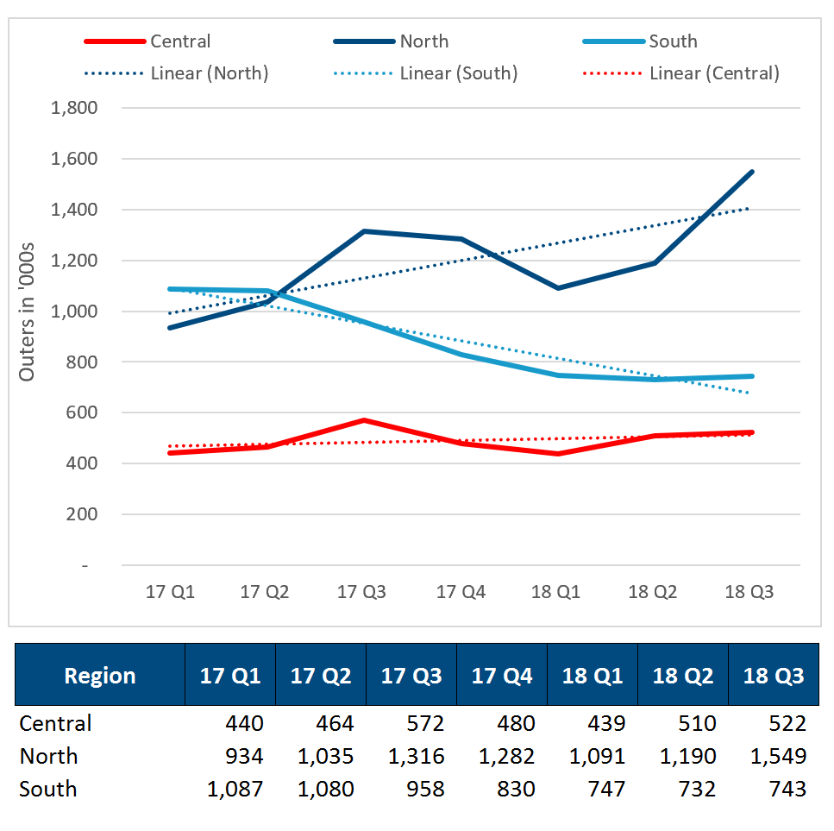
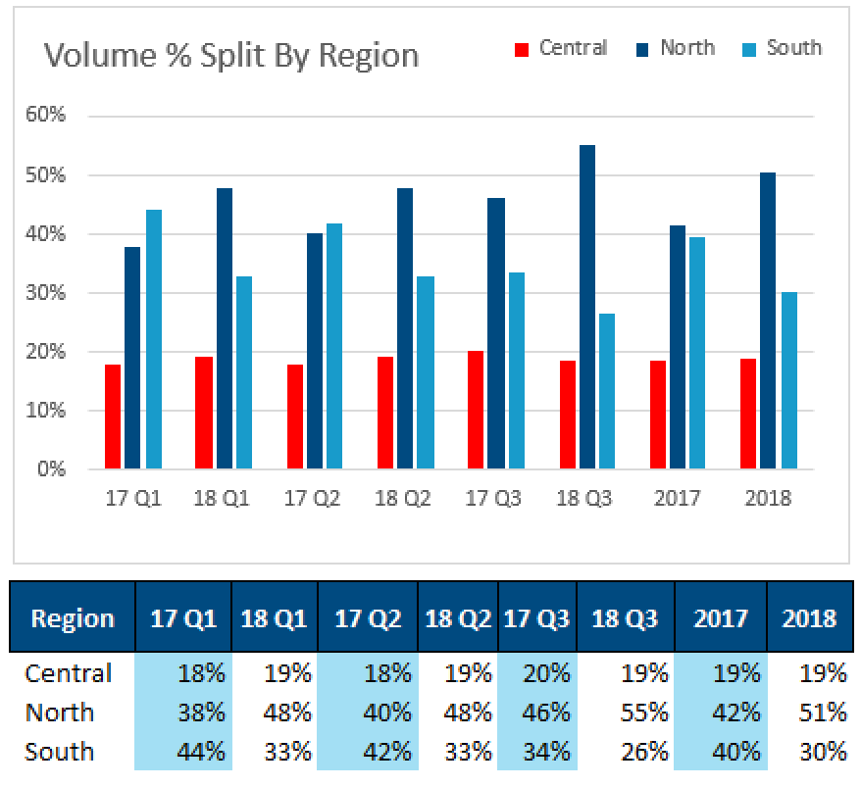
Volume Split Per Region YoY

Slide 4
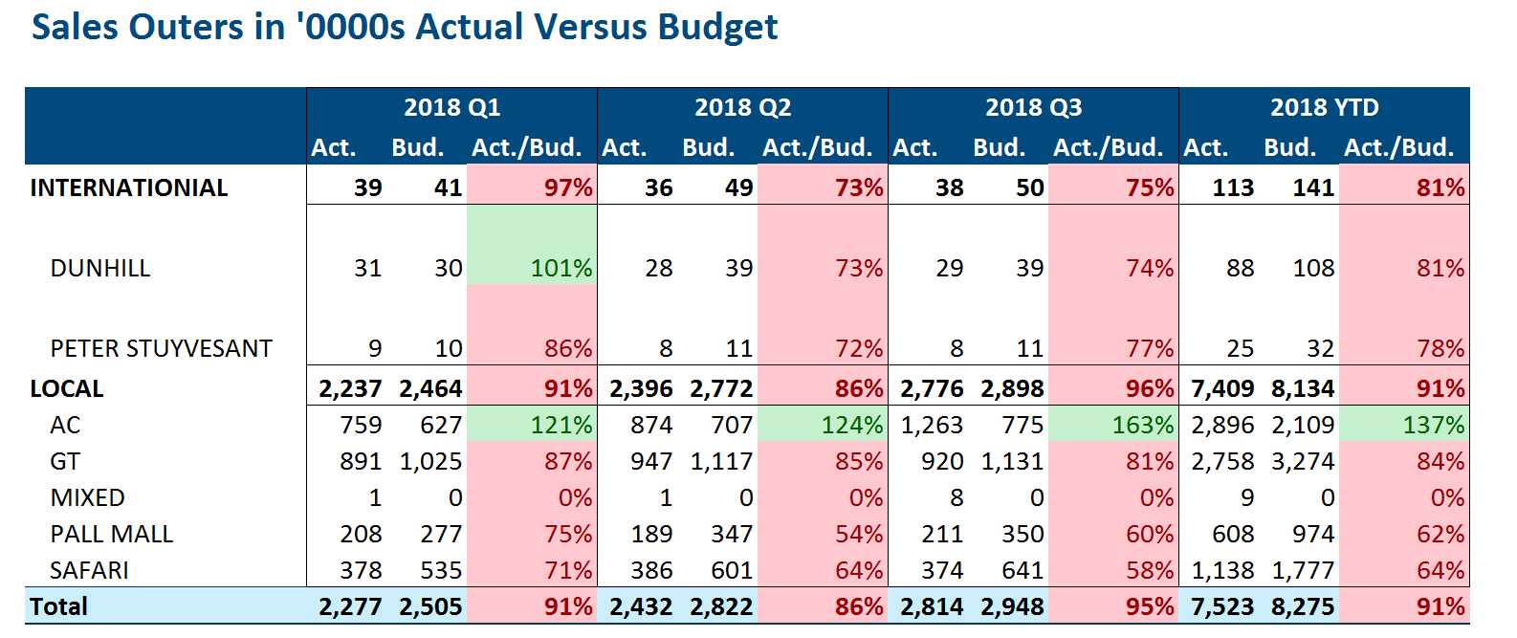
2018 Budget Versus Actual

Slide 5
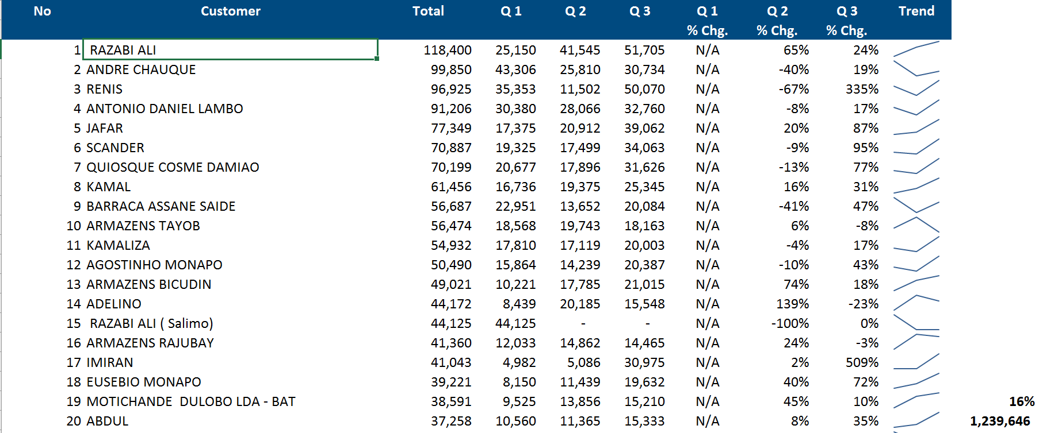
Top Customers: Sales 2018
Total Number of accounts Sold To: 5,655

Slide 6
Branch performance ‘000 Outers

Slide 7
AC Analysis – Outers ‘000

Slide 8
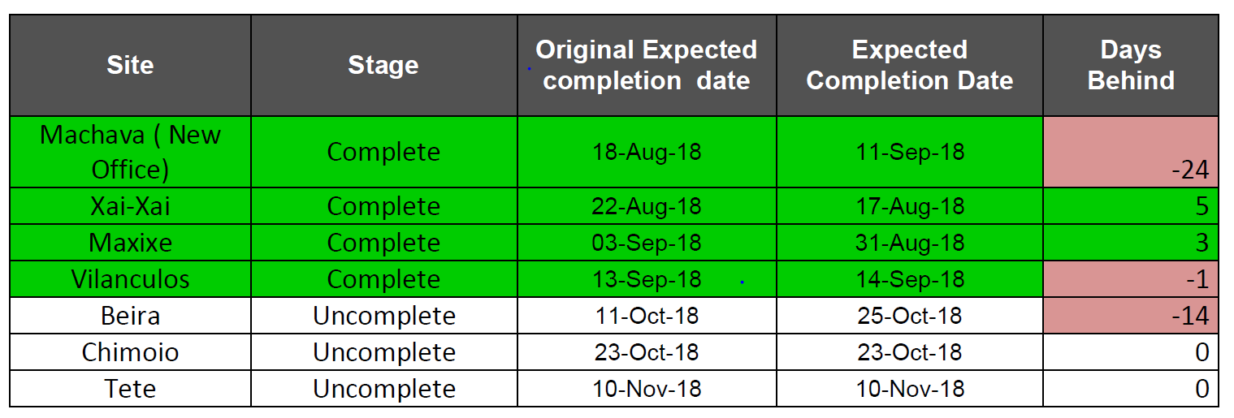
G4S: Phase II Progress
Mocimboa da Praia, Pemba, Nampula, Mocuba, Cuamba, Lichinga are 100% complete in Phase I

Slide 9
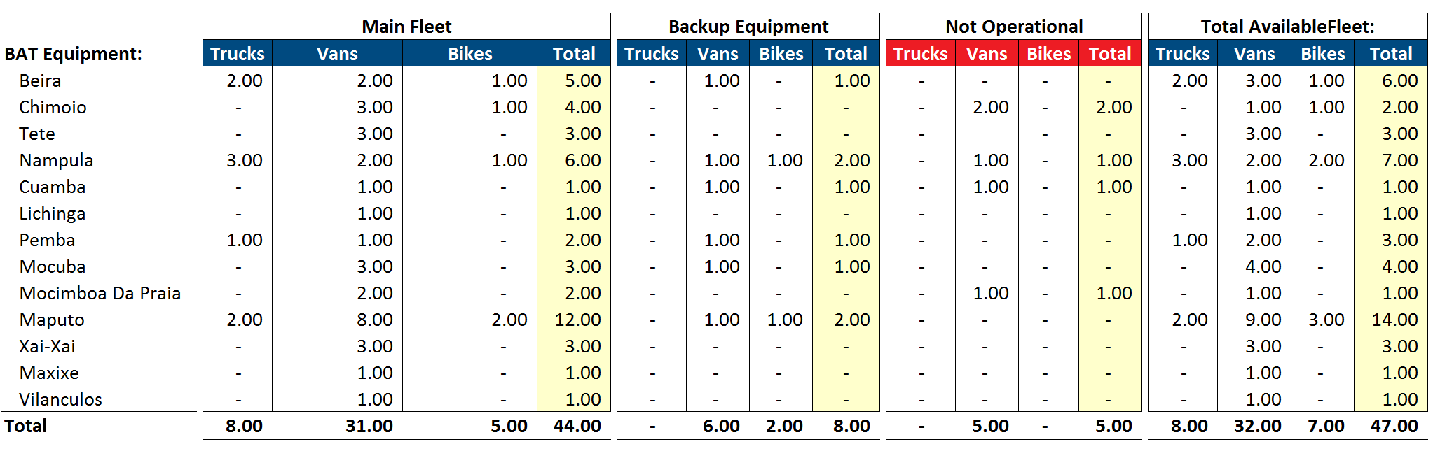
Fleet Analysis

Slide 10
Breakdown report

Slide 11
Vilanculos
Staff (Rep, Depot Manager) all hired;
Training – 15th Oct to 19th of Oct;
Deployment to Depot – 22nd Oct.

Slide 12
Thank you.

